Slide 1
Daily_Report Analysis
File created on: 14-06-2020 00:14:34

Slide 2
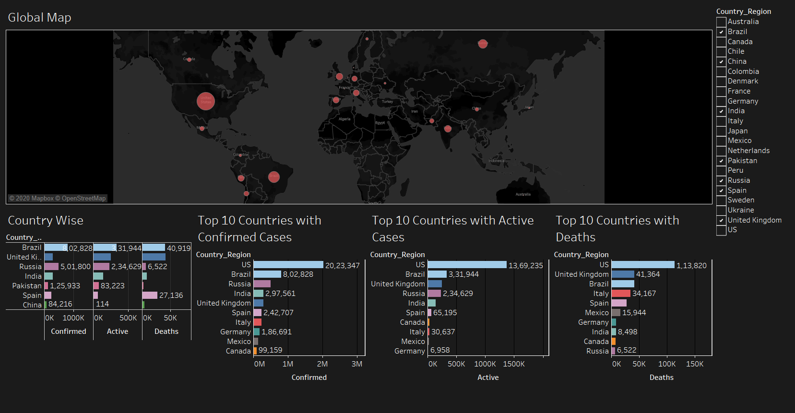

Slide 3
Italy
Area: 301,340 km²
Population : 60,317,116 (2020 estimate)
Population Density: 201.3/km²
The factors behind a coronavirus Epidemic
Old nation
The median age of the overall population was 45.4 last year.
Italians dying of COVID-19 averaging out at 78.5.
Almost 99 percent of them were also suffering from at least one pre-existing condition or ailment.
No lockdown
No Lockdown announced till 22nd March 2020
Bad Luck
The first couple of (locally-transmitted) cases arrived in Italy about 10 days before they arrived in Germany, the United States or Canada.
Close proximity
Italians aren’t used to social distancing. They are very physically affectionate people: Hugs and cheek-kisses are common not just among family members but also friends and even work colleagues.
Dario Nardella, who launched a nationwide campaign to ‘hug a Chinese person’
1st confirmed case: 31st Jan 2020
On 29th Feb Italy has total 1128 confirmed cases.
On 31st March Italy seen sharp increase in cases to 105,792.
Then “The Italian government on 22 March 2020 published a notification that essentially suspends all industrial and commercial activities, with certain exceptions for “essential activities.”
On 30th April cases reach to 205,792.
The effect was so big that even after announcing lockdown 22nd march there was sharp increment in confirmed cases
Now Italy has 225860 confirmed cases,
Currently Italy sees fall of active cases.
Italy begins reopening bars and cafes as rate of deaths and new infections falls.
References:
https://home.kpmg/xx/en/home/insights/2020/04/italy-government-and-institution-measures-in-response-to-covid.html
https://www.msn.com/en-us/news/world/why-italy-the-factors-behind-a-coronavirus-disaster/ar-BB11vu3h.

Slide 4
South Korea
Area: 100,363 km²
Population : 51,709,098 (2019 estimate)
Population Density: 507/km²
1st confirmed case: 20 Jan 2020
On 29th Feb S.K has total 3150 confirmed cases.
S.K is more densely populated country than Italy, still they have a smaller number of case.
On 31st March S.K seen Significant rise in cases to 9661.
Even After S.K Being close geographically to Covid-19 Origin nation China, it seem like S.K succeed to control spread.
On 30th April cases reach to 10,765.
A country to control covid-19 without having to shut down the economy.
On Apr. 15, some 29 million people turned up to vote in parliamentary elections—yet no known infections arose, thanks to strict social distancing at the polls.
Now S.K has 11078 confirmed cases
S.K have only 900 active cases
The factors behind winning the battle against Covid-19
Thanks to early preparations
South Korea raised the alert level to the highest, Red, on 23 February.
Covid-19 diagnosis.
Rapid diagnostic tests for novel coronavirus (nCoV) in Korea have been made available at Korea Centers for Disease Control and Prevention (KCDC)
The test system was made available at a number of private clinics and medical centres too since February.
Limited to travelers from China
South Korea started quarantining visitors from Mainland China, Hong-Kong & Macao when it has 28 confirmed cases.
Quarantine laws amended
To prosecute coronavirus-suspected people who don’t co-operate to get tested for the nCoV.
References:
https://www.pharmaceutical-technology.com/features/coronavirus-affected-countries-south-korea-covid-19-outbreak-measures-impact/
https://time.com/5830594/south-korea-covid19-coronavirus/

